Slide 1
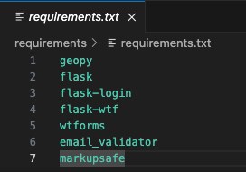
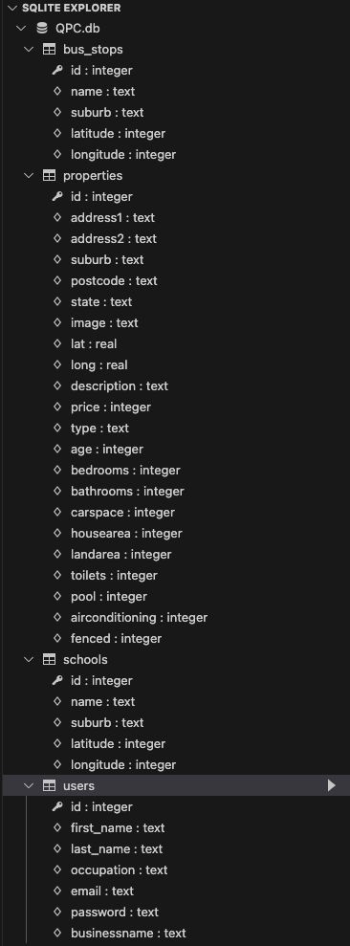
Application structure
libraries
Database tables
Flask app uses the structure
\README.md overview of the product
\requirements\requirements.txt python library dependencies
\static\images\ static images of the houses
\static\fontawesome-free-6.5.1-web\ icons for the property pages
\templates\ the html pages and the jinja templating
\data\ the csv downloads from gov site
\*.py the application code
\QPC.db the SQLlite database
Application code
app.py the main code with the routes for pages
import*.py the import code for bus, school csv and test properties and users
userform.py the user wtfrom to validate the signup
userlogin.py the user for login-manager in session

Slide 2
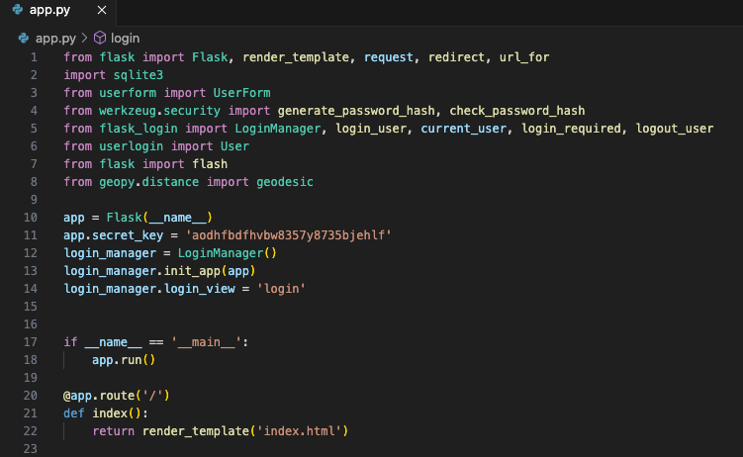
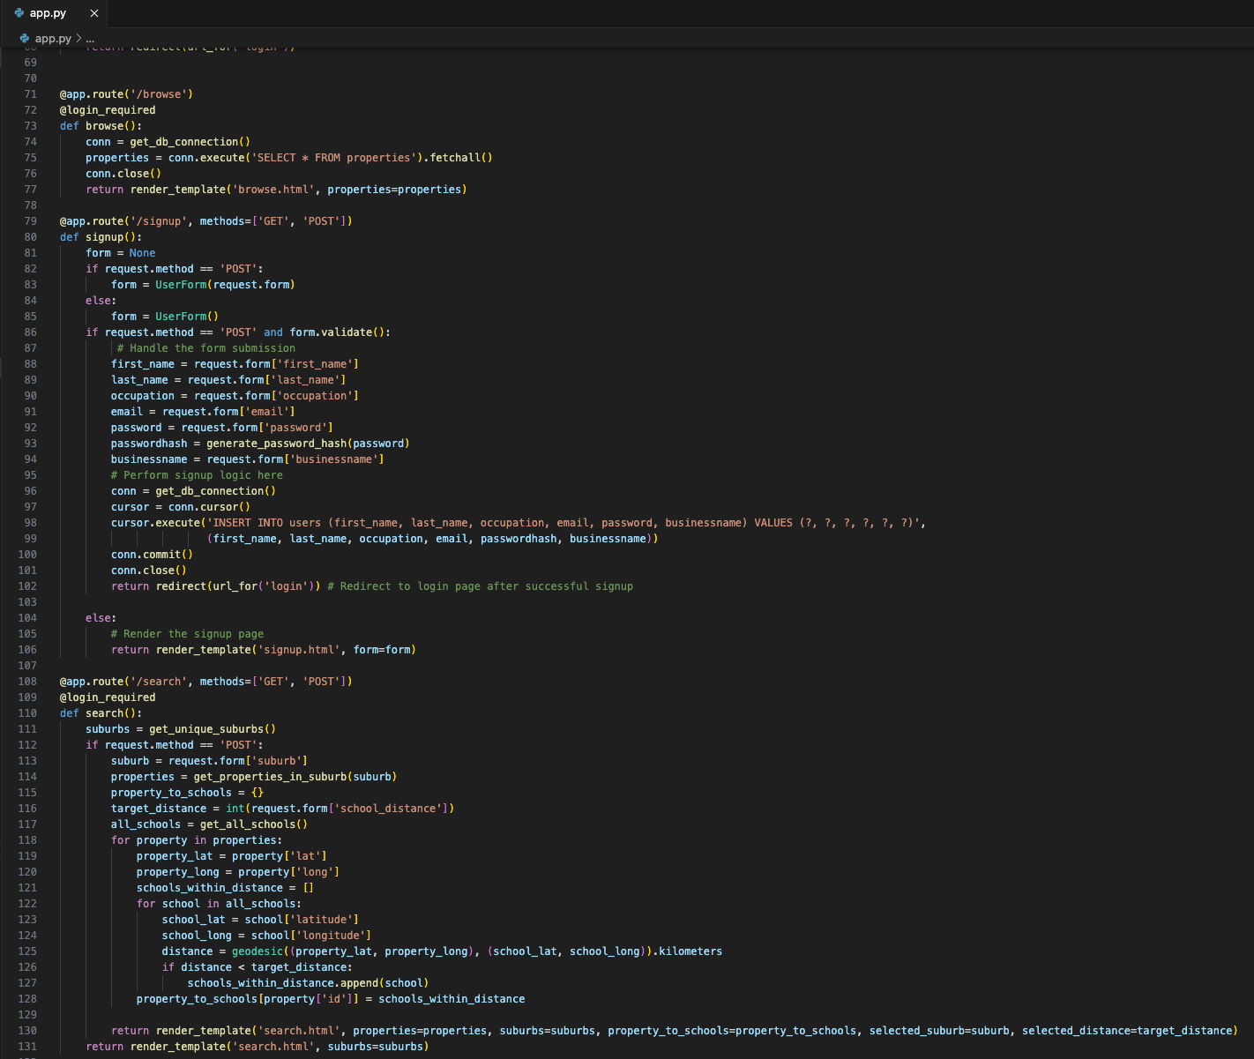
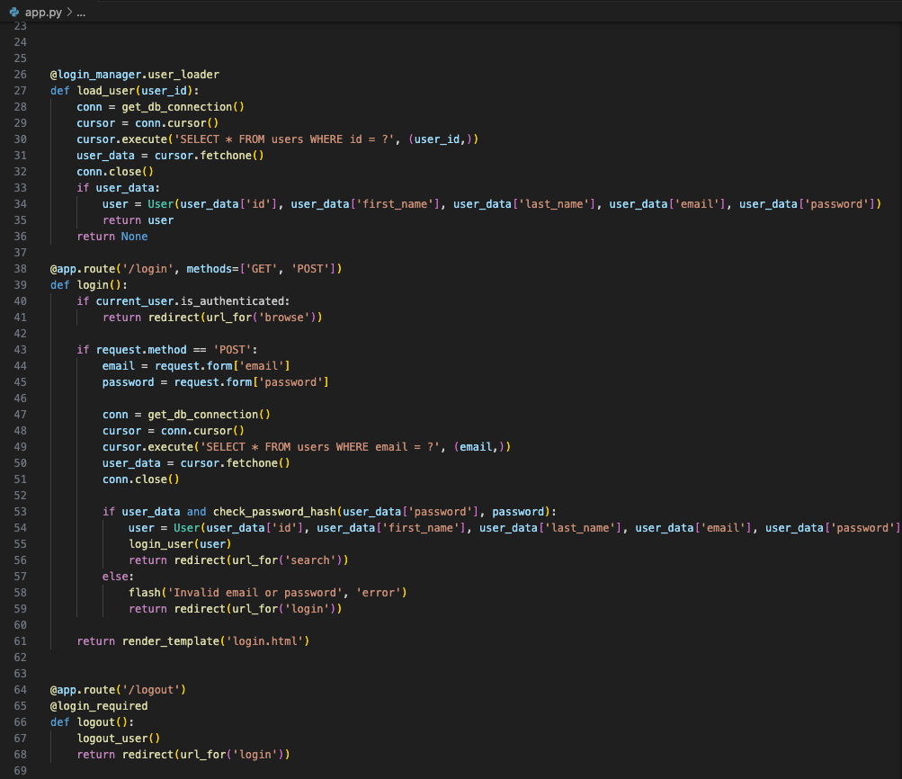
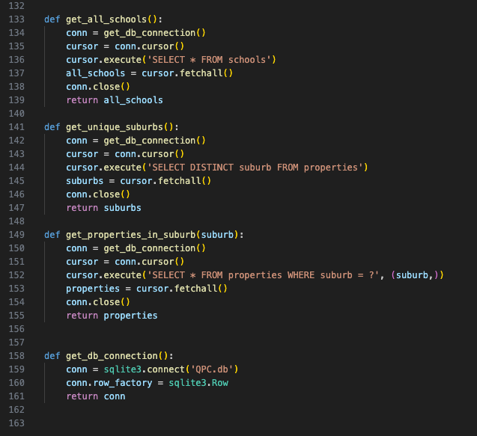
app.py

Slide 3
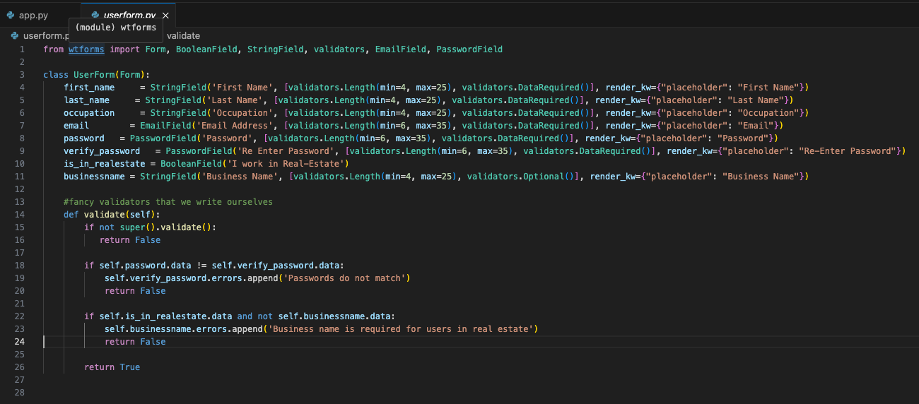
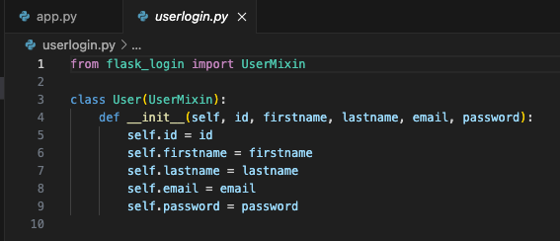
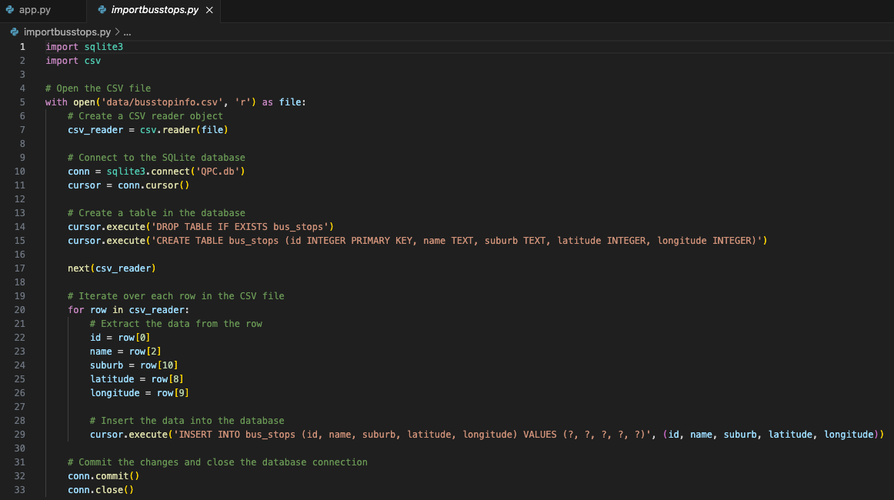
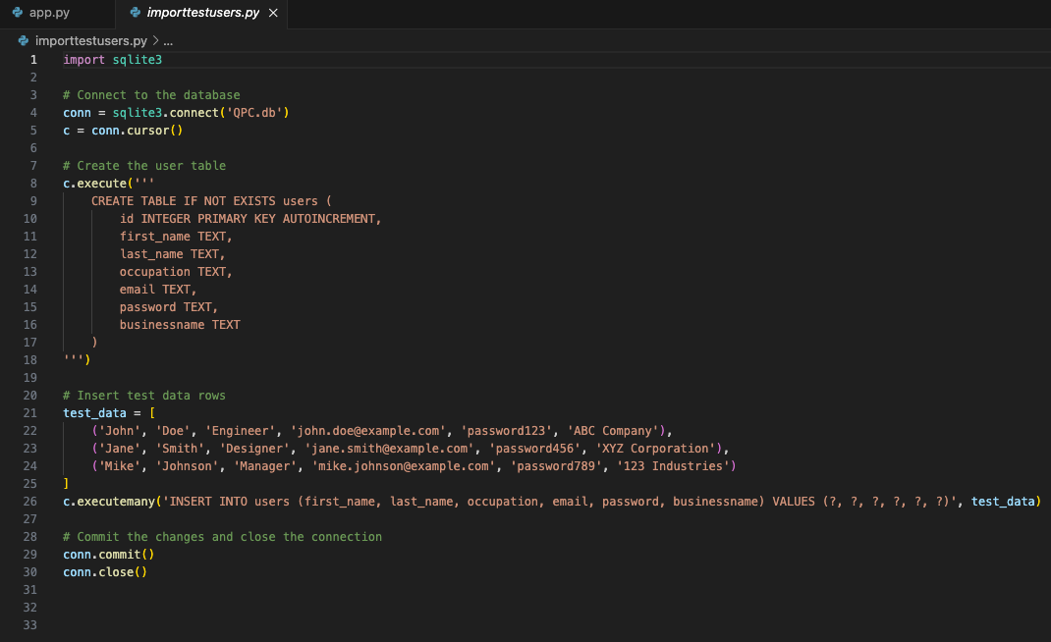
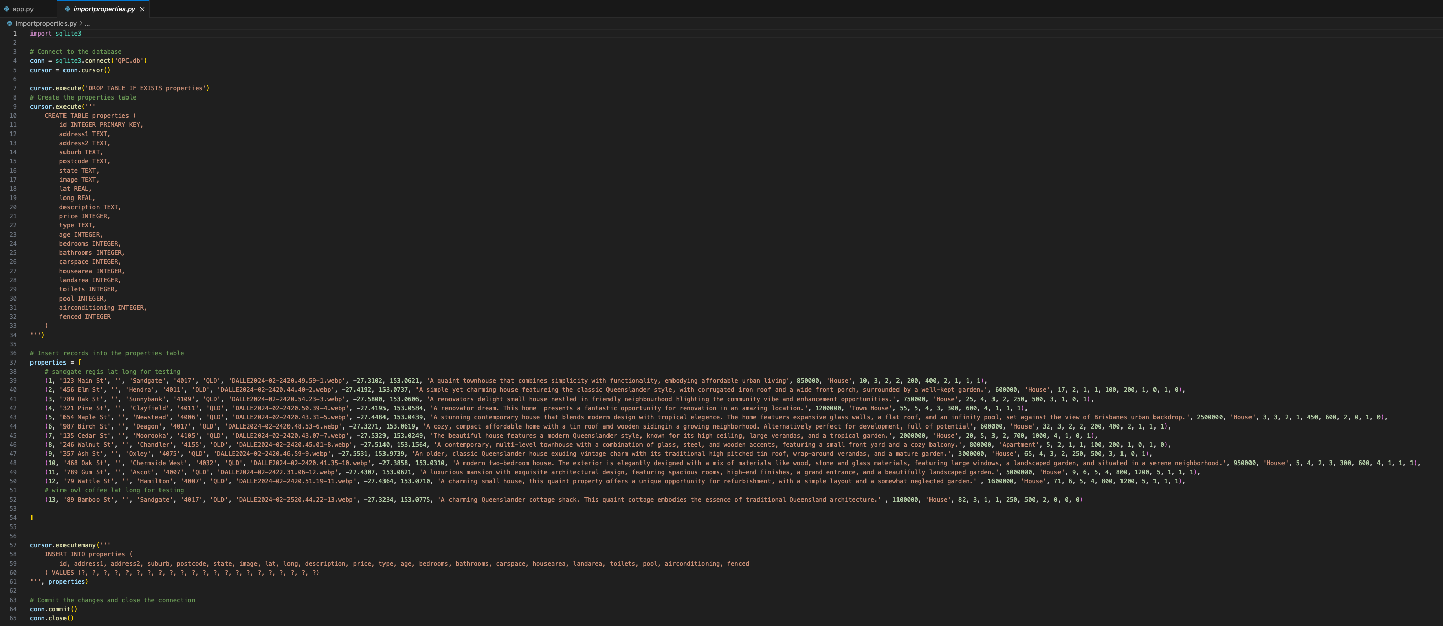
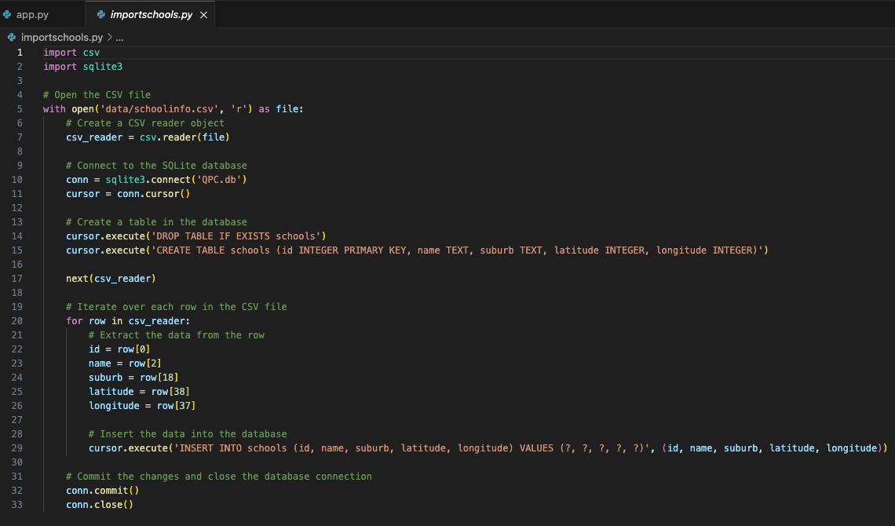
Supporting code
- userform
- userlogin
- import scripts

Slide 4
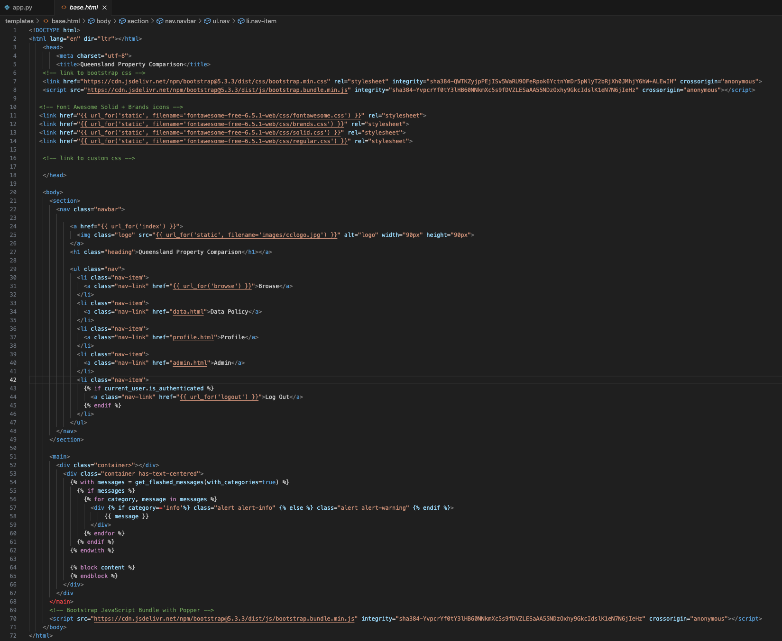
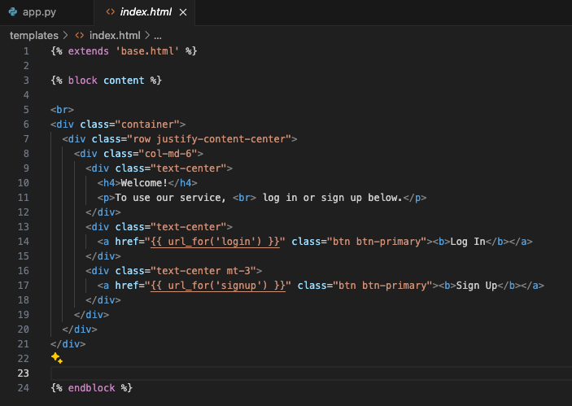
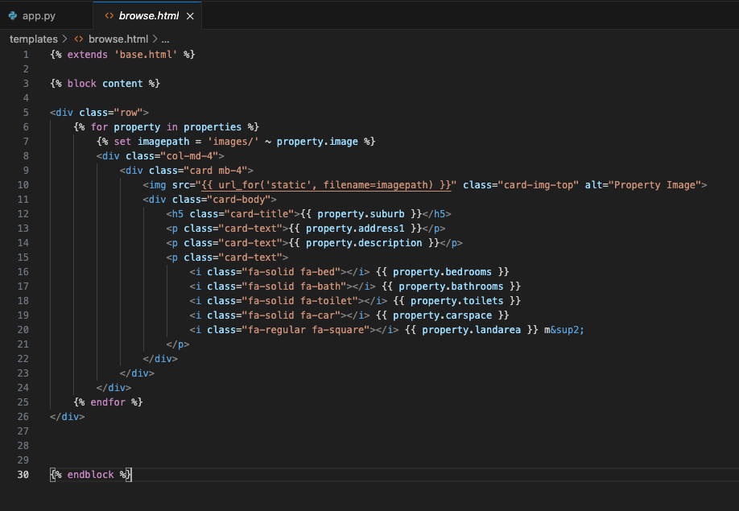
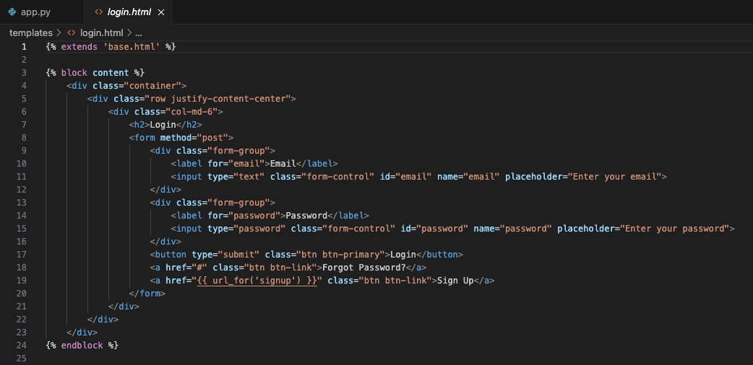
web templates (page 1)
- base includes navigation and messages for all pages
- Index – landing page
- login
- browse

Slide 5
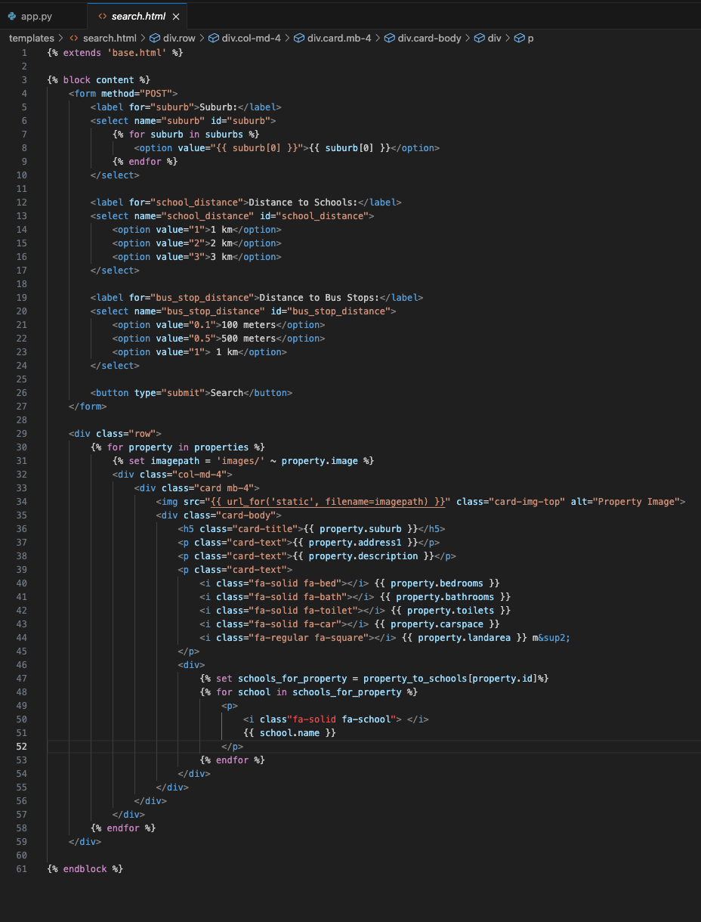
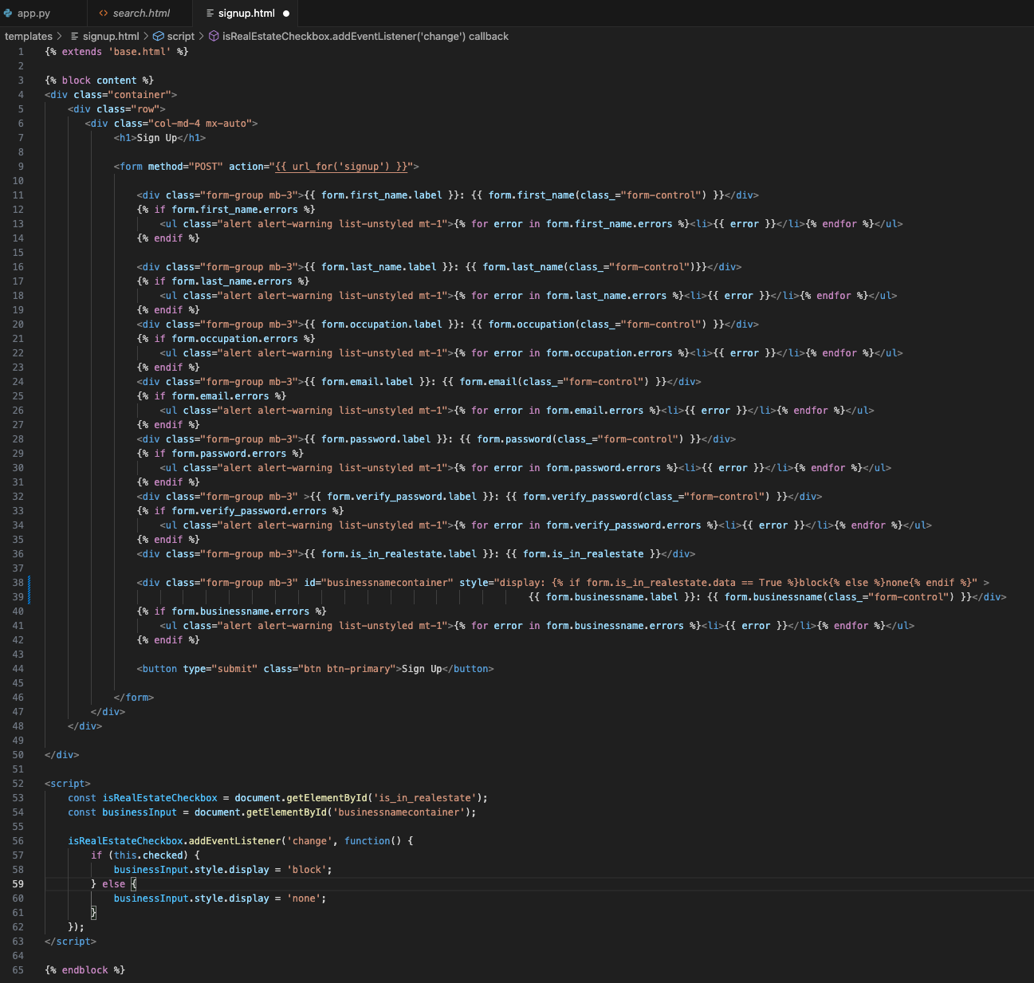
web templates (page 2)
the search and signup pages
Note the ‘alt’ attribute in the ‘img’ is cut off in search screen shot but shows ‘property image’

